Slide 1

Getting started with Angular 5 with Visual Studio Code
ISEP April 2018
Sérgio Azevedo
Senior Software Engineer
Rui Silva
Software Engineer

Slide 2
Who are we?

Slide 3


Who are we?
Senior Software Engineer @Devscope
sergio.azevedo@devscope.net
linkedin.com/in/sergioltazevedo
@thylux
Sérgio Azevedo
Notes:
Interested in all things integration – which of course includes MS Flow

Slide 4

Who are we?
Software Engineer @Devscope
rui.silva@devscope.net
linkedin.com/in/ruisilva450
@ruisilva450
Rui Silva
Notes:
Interested in all things integration – which of course includes MS Flow

Slide 5
DevScope

Slide 6


What we are
consulting
software
saas

Slide 7






consulting
bigdata
business intelligence
integration
cloud
azure
mobile
portals
crm

Slide 8






Slide 9






























Principais Referências

Slide 10






























Slide 11
Preparing the environment

Slide 12
Preparing the environment
Install (if not installed):
Visual Studio Code
NPM
Git
git clone https://github.com/DevScope/HandsOn-Angular
Open /Session 2 - Hands On/resources/angular-vscode-starter folder with Visual Studio Code
Hit Ctrl + Ç to launch the console and run ‘npm install’

Slide 13
Introduction

Slide 14
Agenda
Introduction to Angular
Hands-on: a simple Angular CRUD (create, read, update, delete) application demonstrating components, services, forms and REST services will be created

Slide 15
What is Angular?
HTML/CSS/JS based Application Framework
Cross Platform – web application, desktop applications (Electron, ...) and native applications (Ionic, NativeScript, …)
Speed and Performance – code generation, tree shaking, code splitting
Productivity – templates, CLI, IDEs, Hot Module Reloading (Webpack), testing
Extensive Documentation - https://angular.io/

Slide 16
Application Framework
Angular organizes code through modules, provides UI widgets through components, formats data with pipes, manipulates the DOM through directives, provides access to REST services through the HTTP module, enhances HTML forms, application routing, etc…

Slide 17
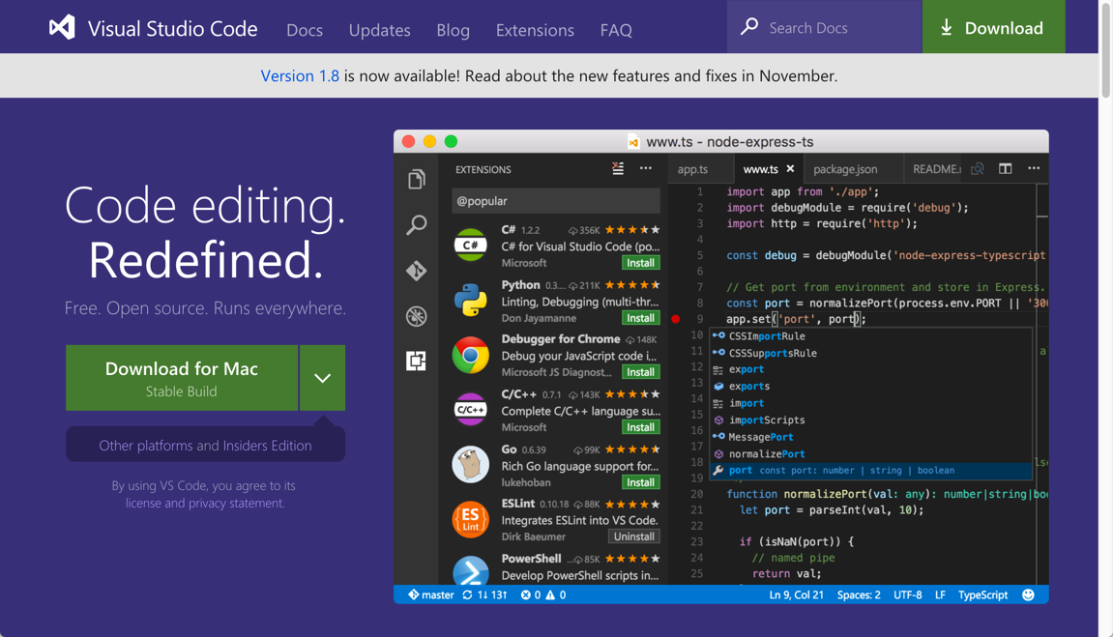
Visual Studio Code
Visual Studio Code is among the most popular editors for coding JavaScript applications
VS Code itself is an Electron-based editor coded with Chromium and Node.js using HTML/CSS/JavaScript
VS Code is an open-source project
http://code.visualstudio.com (runs on Windows, MacOS & Linux)

Slide 18
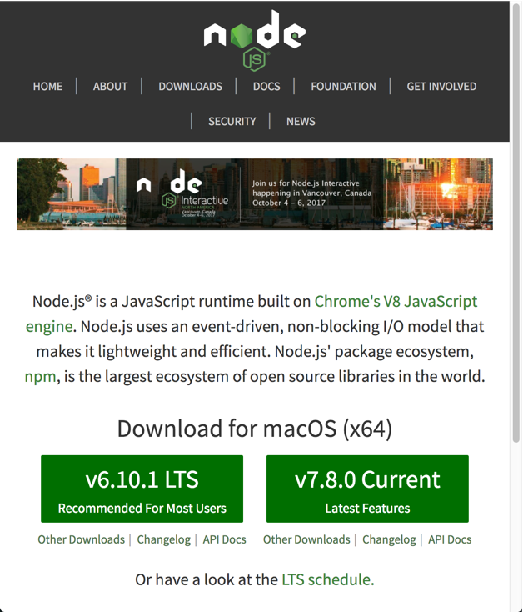
Node.js and NPM
Node.js is server-side JavaScript
Node.js and its package manager, NPM, are used to manage the JavaScript packages needed for the development tool chain including Angular itself

Slide 19
Node.js and NPM
Angular and the application's JavaScript files are bundled with a tool named Webpack
When bundling the files, Webpack runs the files though specially configured loaders such as TypeScript to transpile the code
Webpack also provides the web development server
REST Services are provided by the JSON Server (in this lab)
Webpack and JSON Server are both built with Node.js and distributed via NPM

Slide 20
TypeScript
Angular is a JavaScript based framework
Angular can be coded with JavaScript but TypeScript is preferred
TypeScript transpiles code to JavaScript which is then executed by the browser
TypeScript brings strong-typing to the loosely-typed JavaScript language
Strong-typing supports JavaScript at the enterprise level

Slide 21
SASS
SASS will be used transpile all CSS code in the Angular application
There are two kinds of SASS files
Web Page SASS – produces the application's global stylesheet
Component SASS – produces a component's stylesheet following Web Components CSS standards
Through the use of WebPack, SASS will be loaded, transpiled and added to the JavaScript bundle through the use of import and require statements in the TypeScript code

Slide 22
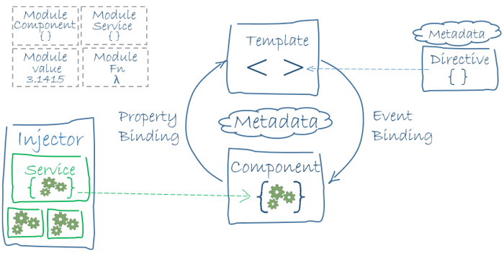
Architecture Overview

Slide 23
Angular: Hello World!
Demonstrates many of the essential elements of an Angular application
App Module – modules contain the custom parts of an Angular application such as custom components and pipes
App Component – components contain the user interface template and user interaction logic, components can be composed with components to build larger components
Main – starting point of the application, loads the App Module, and bootstraps it

Slide 24
Two Module Systems
Two module systems are used to build Angular applications:
ES2015
Angular
ES2015 Modules are provided by JavaScript, one file is one module, and one module is one file

Slide 25
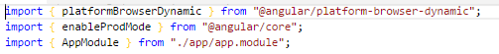
ES2015 Modules
Through the use of Babel and Webpack, ES2015 Modules are available to developers
When Angular is installed in the application via NPM, it can be easily imported using the import syntax of ES2015 modules

Slide 26
Angular Modules
Modules are JavaScript classes decorated with NgModule
NgModule is imported from Angular Core
There are several options which can be configured
imports – includes dependent modules
declarations – includes components, directives and pipes
bootstrap – bootstraps the Angular application with the specified component, typically this is AppComponent
providers – register services for dependency injection

Slide 27
Angular Components
JavaScript class decorated with the Component decorator
Component decorator is imported from Angular Core
The Component decorator supports many options
selector – the CSS selector the component will use as a marker in the DOM to know where to place the component
templateUrl – URL points to the file containing the HTML template
styleUrls – URL pointing to various CSS stylesheets

Slide 28
Angular Services
Services can be created from classes or from values
To create a service with a class all that is need is to define the class, register it with the Angular part, then inject it via the constructor
Services must be registered via the providers option
Each Angular part which will use the service does not need to register it, but it must be registered at the module level for all parts in the module to use it
It is possible to change implementations of a service without having to rewrite a lot of code, and replace concrete instances with mocked versions when unit testing, etc…

Slide 29
Example of Module Registration
Example of Component Registration
@NgModule({
imports: [ BrowserModule ],
declarations: [ AppComponent ],
bootstrap: [ AppComponent ],
providers: [ SomeService ],
})
export class AppModule { }
@Component({
selector: "widget-tool",
template: require("./app.component.html"),
styles: [ require("./app.component.scss") ],
providers: [ SomeService ],
})
export class AppComponent { }

Slide 30
Hands-on Lab

Slide 31
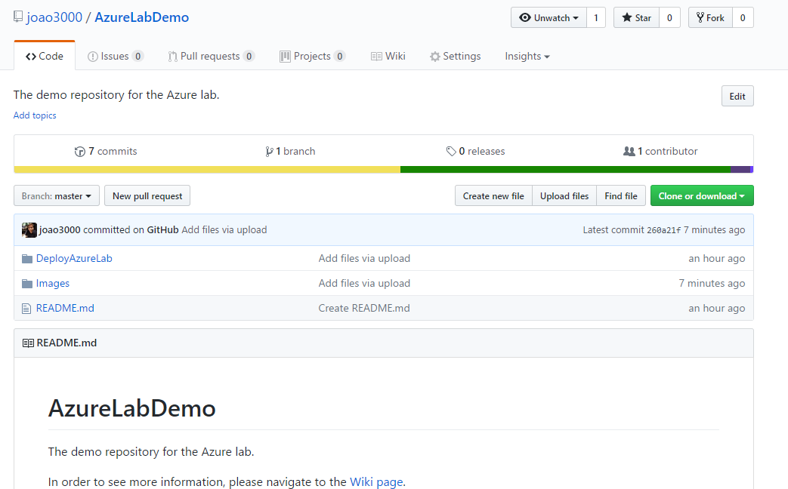
Hands-on Labs

Slide 32
Want to know more?
Tour of Heroes - https://angular.io/tutorial
HTTP connection to API
Angular CLI
Angular Router
https://stackblitz.com/angular/pmkklxdkrva (Live exemple)

Slide 33
Rua Passos Manuel Nº 223 – 4º Andar
4000-385 Porto
T. +351 223 751 350/51
F. +351 223 751 352
info@devscope.net
www.devscope.net
rui.silva@devscope.net
linkedin.com/in/ruisilva450
@ruisilva450
sergio.azevedo@devscope.net
linkedin.com/in/sltazevedo
@thylux

